Slide 1
Retail Forecasting
Data Forecasting Team

Slide 2
Problem Description:
The large beverage company in Australia needs to forecast demand for each of their products at the
item level, on a weekly basis. Their sales are influenced by various factors including promotions, holidays, and seasonality. The company currently uses an in-house software solution for forecasting,
but it often produces unreliable results. They want to explore AI/ML-based forecasting to replace their current system.

Slide 3
Business Understanding
Business Objectives:
• Develop an AI/ML-based forecasting model that can accurately predict weekly demand for each product
• Improve forecast accuracy compared to the current in-house solution
• Account for various influencing factors such as promotions, holidays, and seasonality
• Enable better inventory management and production planning
• Optimize promotional strategies based on accurate demand predictions
Target Audience:
• Sales and Operations Planning team
• Inventory Management team
• Production Planning team
• Marketing team (for promotional planning)

Slide 4
Data Understanding
The dataset we are analyzing is the “forecasting_case_study.xlsx” file, which contains 1218 rows and
12 features, comprising of “Product”, “date”, “Sales”, “Price Discount (%) ”, “In-Store Promo”,
“Catalogue Promo”, “Store End Promo”, “Google_Mobility”, “Covid_Flag”, “V_DAY”, “EASTER”
and “CHRISTMAS”. Surprisingly, there were no missing data in the file
The dataset contained six unique Products: SKU1, SKU2, SKU3, SKU4, SKU5, SKU6

Slide 5
Data Understanding
1. Product: SKU identifier (SKU1, SKU2, etc.) Dtype: object
2. Date: Weekly dates from 2017 to 2020 Dtype: object
3. Sales: Numeric sales figures Dtype: int64
4. Price Discount (%): Percentage of price discount offered Dtype: object
5. In-Store Promo: Binary (0 or 1) indicating in-store promotions Dtype: int64
6. Catalogue Promo: Binary (0 or 1) indicating catalogue promotions Dtype: int64
7. Store End Promo: Binary (0 or 1) indicating store end promotions Dtype: int64
8. Google_Mobility: Numeric values (possibly related to Google's mobility reports during COVID-19) Dtype: float64
9. Covid_Flag: Binary (0 or 1) indicating COVID-19 period Dtype: int64
10.V_DAY: Binary (0 or 1) possibly indicating Valentine's Day Dtype: int64
11.EASTER: Binary (0 or 1) indicating Easter holiday Dtype: int64
12.CHRISTMAS: Binary (0 or 1) indicating Christmas holiday Dtype: int64

Slide 6
Data Understanding
Sales Data Analysis: Insights and Trends
Dataset: Sales data from February 2017 to December 2020
Products: SKU1, SKU2, SKU3, SKU4, SKU5, SKU6
Key variables: Sales, Promotions, Holidays, and COVID-19 impact

Slide 7
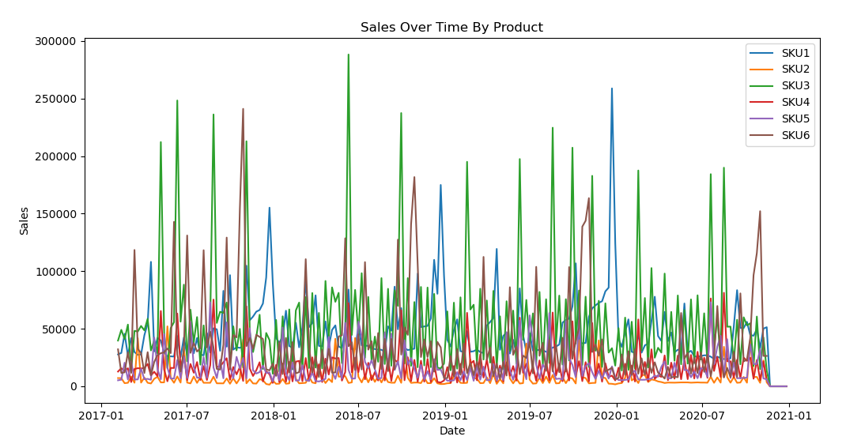
Sales Overview
Sales Data Analysis: Insights and Trends
Overall Increasing Trend In sales from Feb 2017 to Dec 2020
Significant spikes in sales, likely due to promotional activities
Noticeable seasonality, with higher sales during certain periods

Slide 8
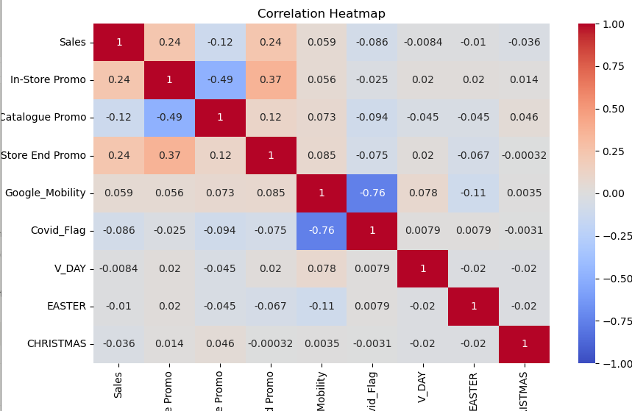
Key Insights
Sales Drivers and Patterns
Promotions Impact: In-store promotions (correlation: 0.24) and Store End promotions (correlation: 0.24) have a positive effect on sales
Seasonal Effects: Most of the seasons have negative correlations with Easter (-0.01), V_Day (-0.0084) and negative Christmas (-0.036)
COVID-19 Impact: Negative correlation (-0.086) between sales and COVID-19 flag, indicating a slight decrease in sales during the pandemic

Slide 9
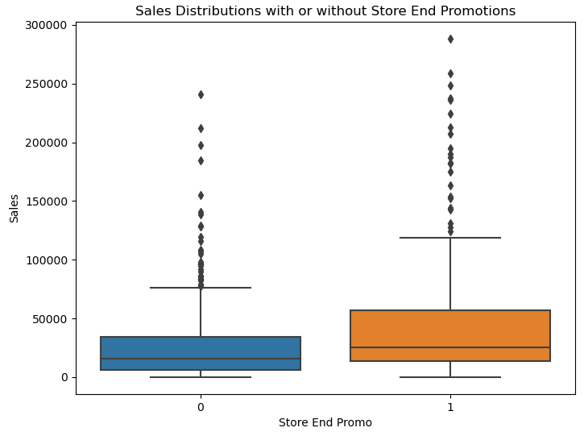
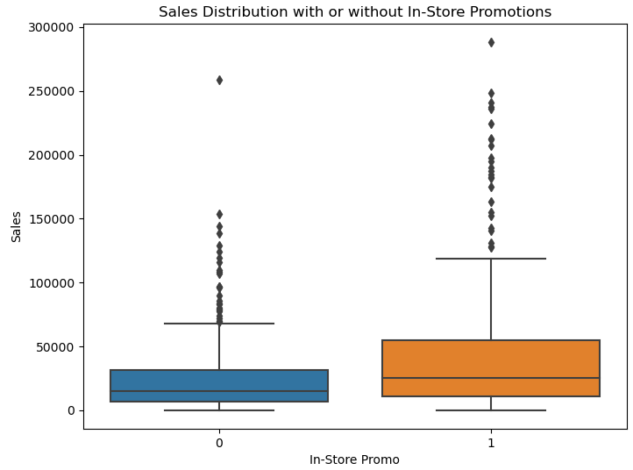
How Promotions Effect Sales

Slide 10
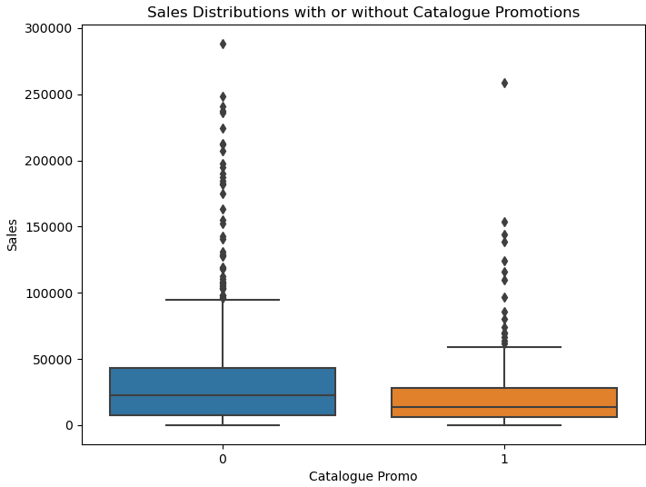
How Promotions Effect Sales
In the first two box plots, we noticed there was an increase in Sales on the In-Store and End Store Promotion, but the opposite effect for Catalogue Promotions.
This indicates that sellers should be more invested in these type of promotions

Slide 11
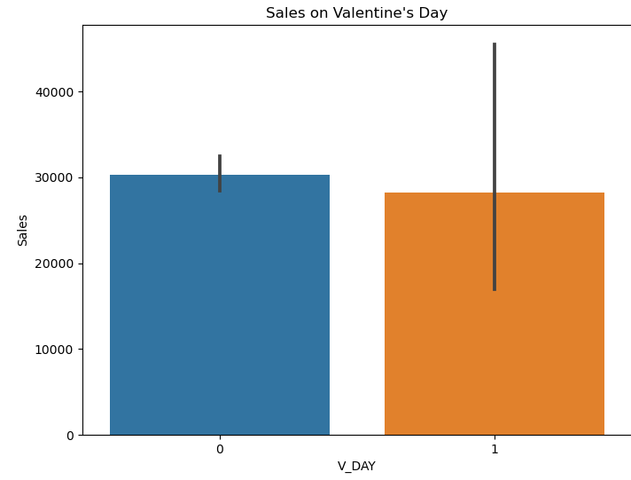
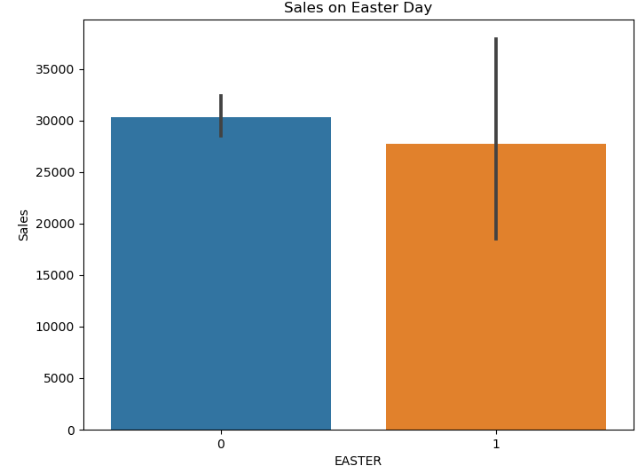
Seasonal Effects of Sales

Slide 12
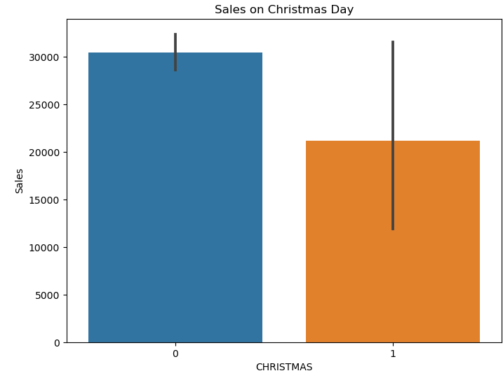
Seasonal Effects of Sales
From our box plot, apart from the outlier indicating a small increase in sales, we see that there was a decrease in Sales on Festive Seasons
This tells us that the holidays don't have much impact on the sales of these products.

Slide 13
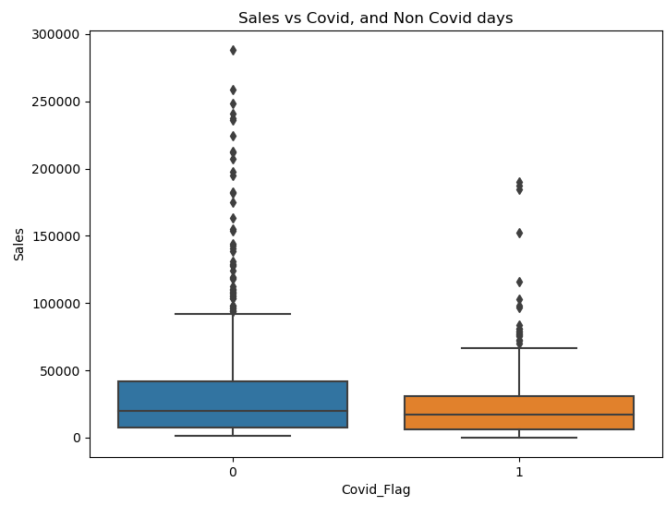
COVID-19 Impact on Sales
We can observe from the box plot on the right that COVID has a negative influence on the Sales of such product.
This helps us understand that a pandemic could affect sales in a negative way.

Slide 14
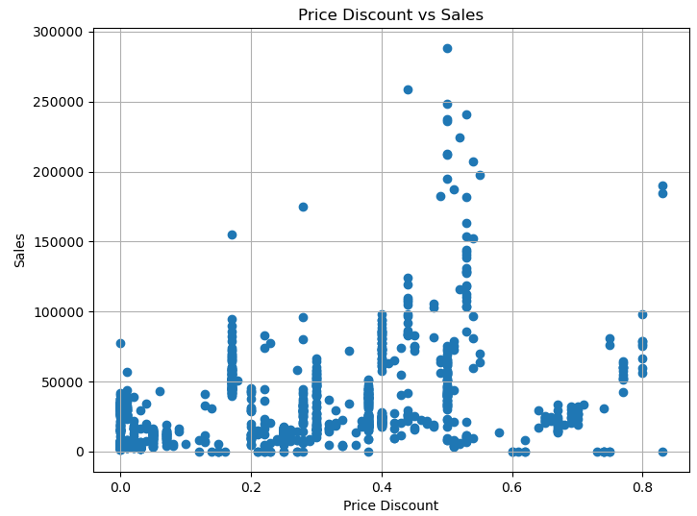
Other External Factors
Price Discount
From the scatter plot on the right, we see that the densely populated % is between 0 to 0.58. After that there's little to no correlation with the Sales

Slide 15
Recommendations
From my observations on the products, SKU3 has the highest spikes, indicating that it's influenced by Promotions.
SKU2 product has the least spike, even though it made the most sales throughout the 3 years, so its value isn't influenced by seasonality or promotions
Even though SKU6 made the lowest sales, it has the same pattern of spikes of SKU3, also signifying how its sales are moved by promotions.
The Seller should focus more on giving In-Store and End Promotions for most of their products, and maintain the price discount to 0.2.

Slide 16
Model Recommendation
One should use a Linear Regression Model
Benefits of Using a Linear Regression Model
Strength: Focuses on the relationship between sales and external predictors like promotions, discounts, or events. It assumes these relationships are linear and consistent over time.
Implication: A relatively low RMSE(root mean square error) implies the external factors are strong predictors of sales, and time-dependent patterns (like seasonality or trends) may not dominate the data.

Slide 17
Model Recommendation
Advisable to Use Random Forest Regressor
Benefits of Using Random Forest Regressor
Strength: Handles non-linear relationships and interactions between variables well. It doesn't assume a fixed functional form like Linear Regression.
Accuracy: In the modified version we made an accuracy estimate of all of the models used (Linear, Random, SVR and Gradient Boosting) and we see that the Random Forest Regressor has the best forecasting accuracy for forecasting sales.

Slide 18
Model Recommendation
Time Dependent Models such as AMIRA
Benefits of Using ARIMA
Strength: Focuses on temporal dependencies and trends by modeling the relationship between sales and its own past values (lags) and changes.
Implication: ARIMA is useful if sales show a strong temporal pattern (like steady growth, periodic fluctuations, or trends). The poor performance of ARIMA (as indicated by potential issues in its residuals) suggests that external factors play a more significant role in driving sales than just its past values.

Slide 19
Information for Technical Users
# Evaluating Model Performance with a Linear Regression model
from sklearn.model_selection import train_test_split
from sklearn.linear_model import LinearRegression
from sklearn.metrics import mean_squared_error
# Select features and target variables
X = forecasting_df[["In-Store Promo", "Catalogue Promo", "Store End Promo", "Google_Mobility", "Covid_Flag", "V_DAY", "EASTER", "CHRISTMAS"]]
y = forecasting_df["Sales"]
# Split data into training and testing sets
X_train, X_test, y_train, y_test = train_test_split(X, y, test_size=0.2, random_state=42)
# Train a linear regression model
lg = LinearRegression()
lg.fit(X_train, y_train)
# print(X_train, "\n:",y_train)

Slide 20
Information for Technical Users
# Predict the test set
y_pred = lg.predict(X_test)
# print(y_pred)
# Calculate the Root Mean Square Error
rmse = np.sqrt(mean_squared_error(y_test, y_pred))
print(f"RMSE: {rmse}")
# Evaluating Model Performance with a Random Forest Regressor
from sklearn.ensemble import RandomForestRegressor
# Train a Random Regressor model
rf = RandomForestRegressor(n_estimators=100, random_state=42)
rf.fit(X_train, y_train)

Slide 21
Information for Technical Users
# Predict the test set
y_pred_rf = rf.predict(X_test)
# Calculate RMSE for the Random Forest Regressor model
rf_rmse = np.sqrt(mean_squared_error(y_test, y_pred_rf))
print(f"rfRMSE: {rf_rmse}")
# Using Time Series Forecasting with ARIMA
from statsmodels.tsa.arima.model import ARIMA
# ARIMA model on sales data
sales_series = forecasting_df["Sales"]
ts = ARIMA(sales_series, order=(5,1,0))
model_fit = ts.fit()
print(model_fit.summary())

